Slide 1


Slide 2
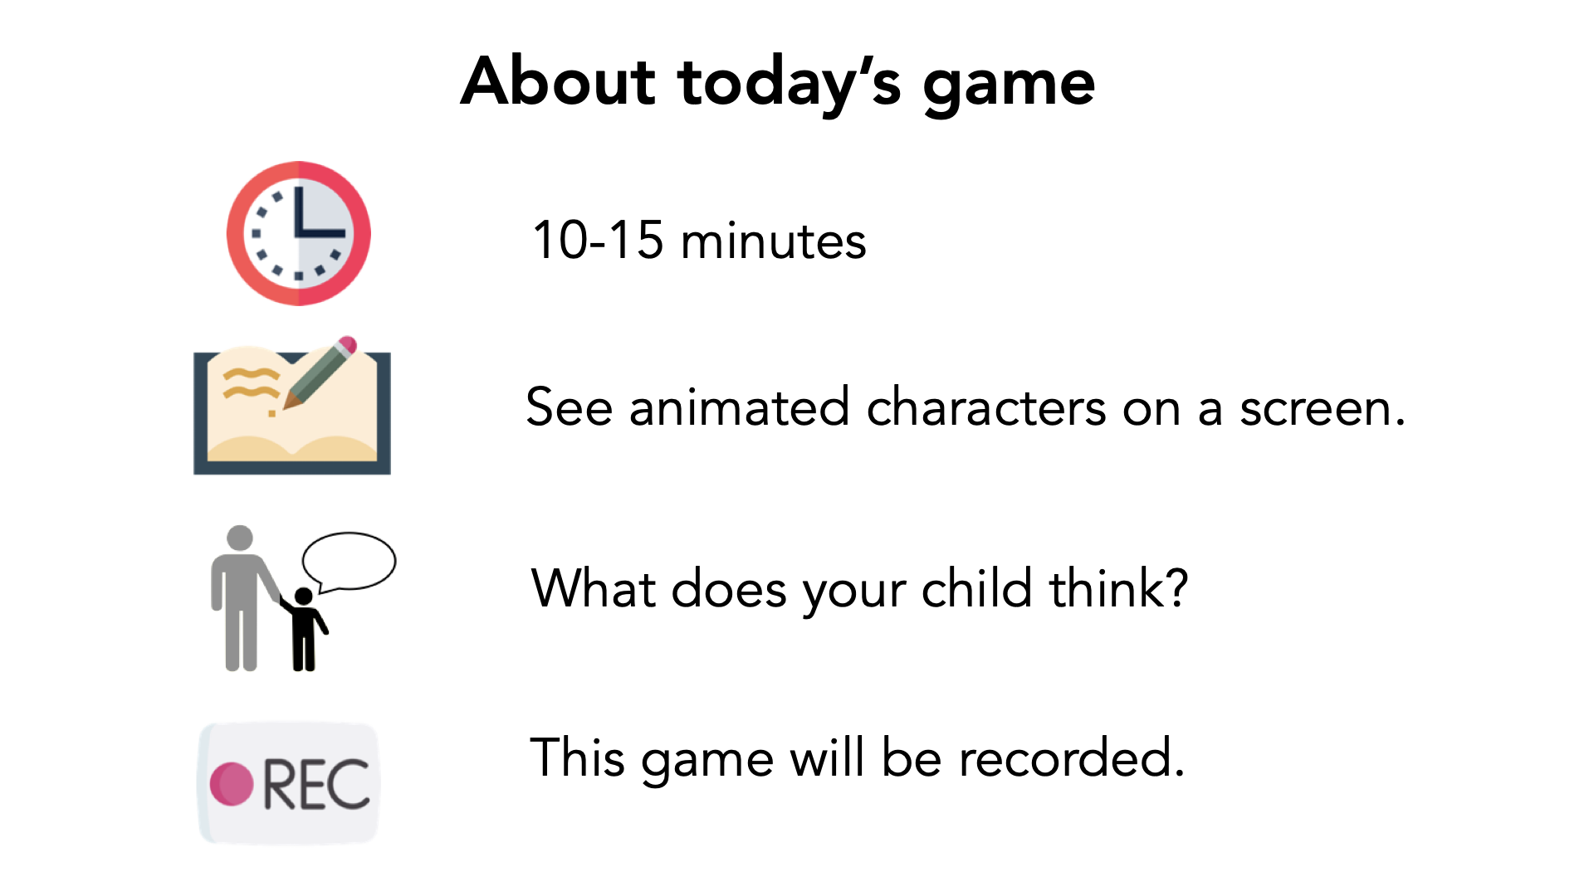

Slide 3
Verbal Consent
"I have read and understand the consent document. I am this child's parent or legal guardian and we both agree to participate in this study."

Slide 4


Slide 5

Notes:
This is Jamie! [click] I am going to tell you a story about her! Jamie feels happy today [click] and she doesn’t know why.

Slide 6

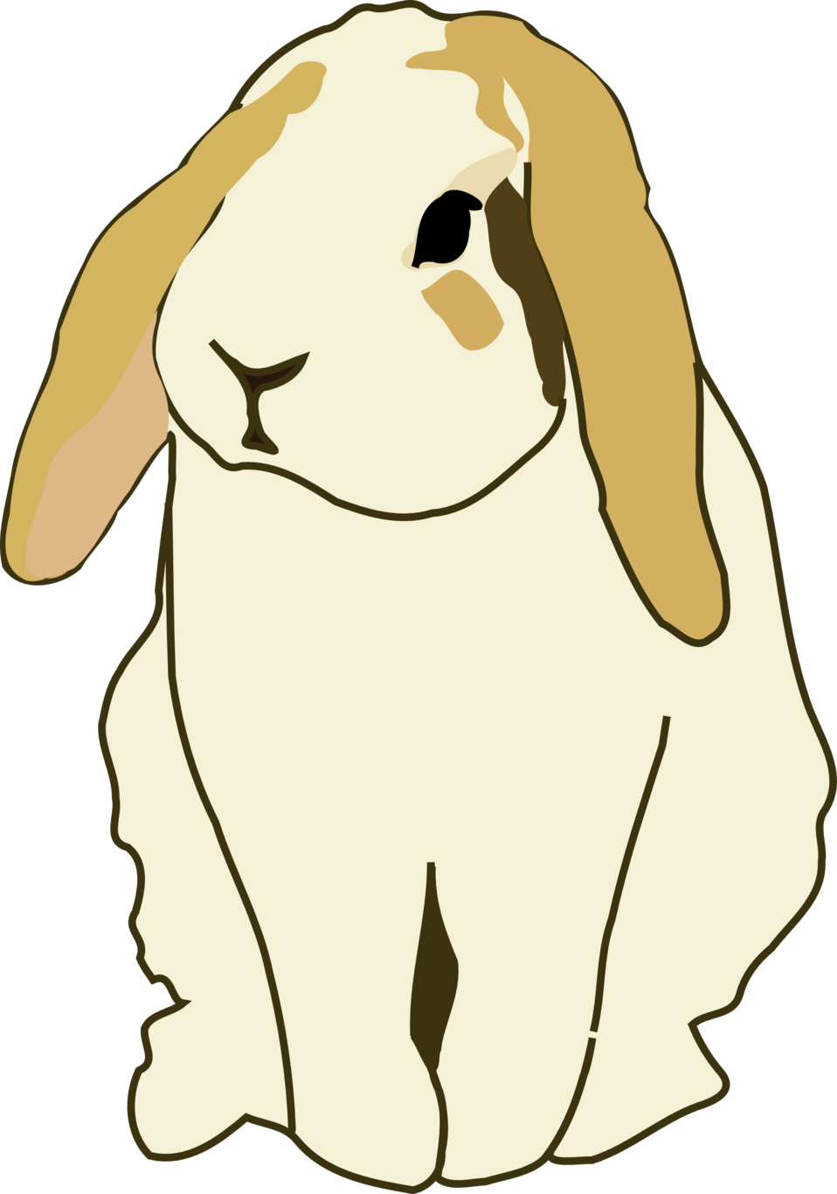

Notes:
In school today, Jamie learned that rabbits move by using their back legs to hop.

Slide 7
Notes:
And Jaime is still feeling happy, even after learning an interesting fact about rabbits.

Slide 8


Notes:
This one is Jamie’s friend

Slide 9
Notes:
and this one is Jamie’s super close best friend. Jamie is going to run into both of them on the way home.

Slide 10



Notes:
After school. Jamie saw her super close best friend named Taylor. Taylor said “Hi Jamie! How was school today?”
Do you think Jamie will tell her super close best friend Taylor about feeling happy today or about the rabbits? [click 2x]
Why?

Slide 11
Notes:
after school, Jamie saw her friend named Robin. Robin said “Hi Jamie! How was school today?”
Do you think Jamie will tell her friend Robin that she is feeling happy today or about the rabbits? [click 2x]
Why?

Slide 12





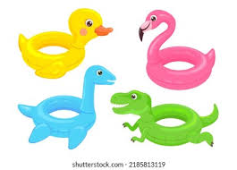
Notes:
Later that day, Jamie went to the pool and saw a friend who she wanted to become super close best friends with.
If Jaime wanted to share something that would make them become super close best friends, Do you think Jaime will tell them about feeling happy today or about the rabbits? Why?
[click 2x]

Slide 13



Notes:
Then Jamie saw her friend’s mom who ALSO felt happy today and learned a fact about lizards at work, Jamie said “Hi! How was your day?”
Do you think Jamie’s friend’s mom will tell Jamie the fact about lizards or that she’s feeling happy? Why?

Slide 14
Notes:
Then Jamie saw her mom who ALSO felt happy today and learned a fact about racoons at work. Jamie said “Hi mom! How was your day?”
Do you think Jamie’s mom will tell Jamie the fact about raccoons or that she is feeling happy today? Why?

Slide 15
Sad Condition

Slide 16


Notes:
This is Skylar! [click] I am going to tell you a story about him!
Skylar feels sad today [click] and doesn’t know why

Slide 17

Notes:
In school today, Skylar learned that owls move by silently flapping their wings

Slide 18
Notes:
But Skylar is still feeling sad, even after he learned an interesting fact about owls.

Slide 19


Notes:
and this one is Skylar’s friend.

Slide 20
Notes:
This one is Skylar’s super close best friend, Skylar is going to run into both of them on the way home.

Slide 21

Notes:
After school, Skylar saw his super close best friend named Peyton. Peyton said “Hi Skylar! How was school today?”
Do you think Skylar will tell his best friend Peyton about feeling sad or about the owls?. [click 2x]
Why?

Slide 22
Notes:
then Skylar first saw his friend named Finley. Finley said “Hi Skylar! How was school today?”
Do you think Skylar will tell his friend Finley that he is feeling sad today or about the owls?. [click 2x]
Why?

Slide 23

Notes:
Later that day, Skylar went to the pool and saw a different friend who he wanted to become super close best friends with.
If Skylar wanted to share something that would make them become super close best friends, Do you think Skylar will tell them that he is feeling sad today or about the owls? Why?
[click 2x]

Slide 24


Notes:
Then Skylar saw his friend’s mom who ALSO felt sad today and learned a fact about geese, Skylar said “Hi! How was your day?”
Do you think Skylar’s friend’s mom will tell Skylar the fact about geese that she learned at work or that she’s feeling sad? Why?

Slide 25
Notes:
Then Skylar saw his mom who ALSO felt sad today and and learned a fact about foxes work. Skylar said “Hi mom! How was your day?”
Do you think Skylar’s mom will tell Sklyar the fact about foxes she learned at work or that she is feeling sad today? Why?

Slide 26
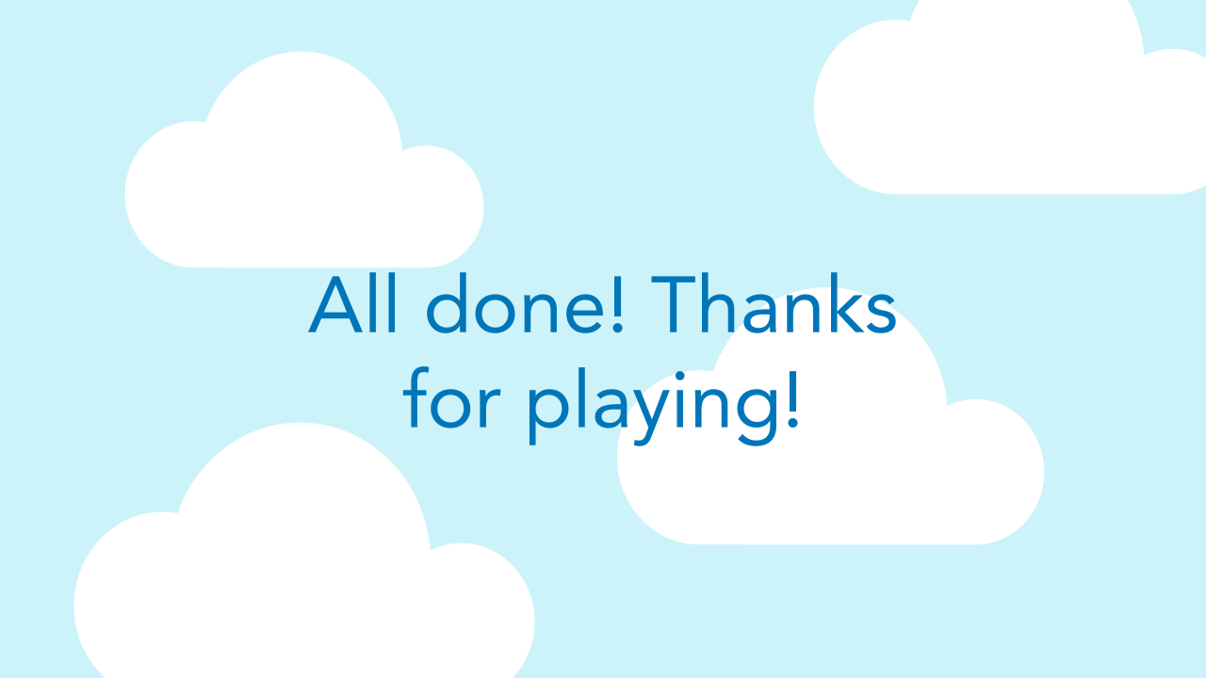

Slide 27
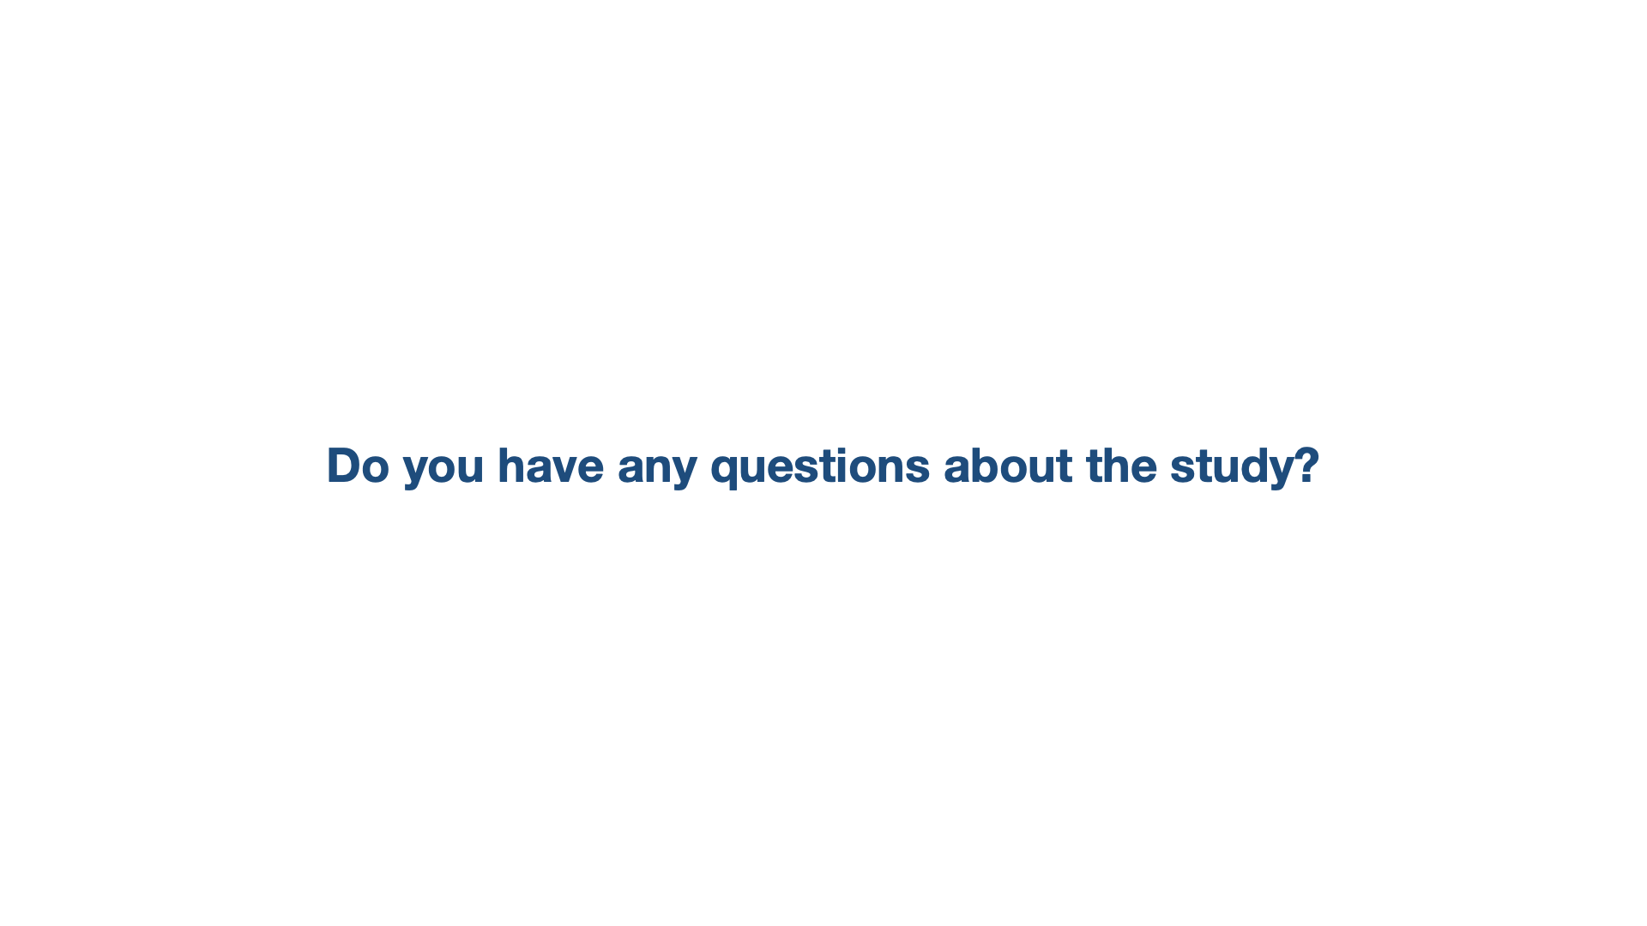

Slide 28
